Slide 1
Compiler Design using PLY language
Presented by:
Aditya Dixit

Slide 2
What is Compiler?

Slide 3
How problem is solved?

Slide 4
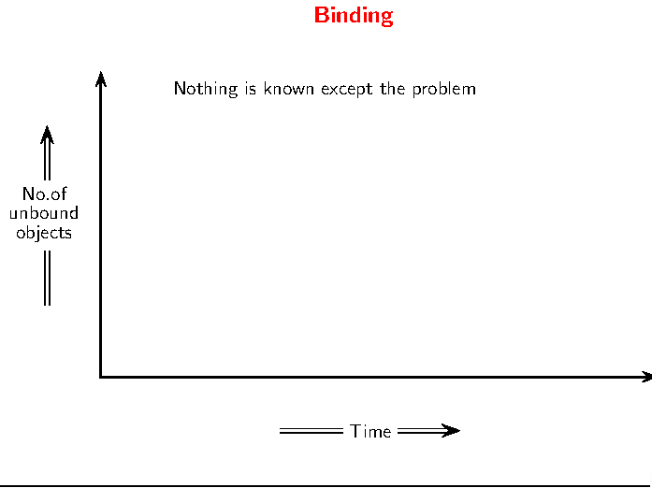

Slide 5
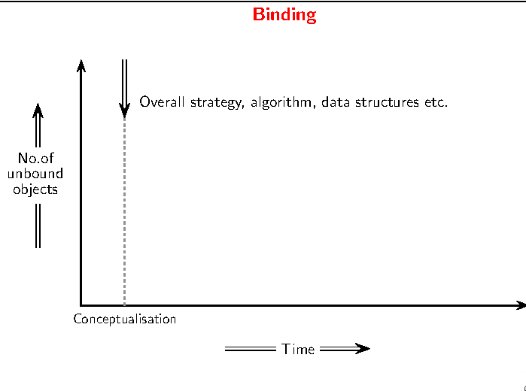

Slide 6
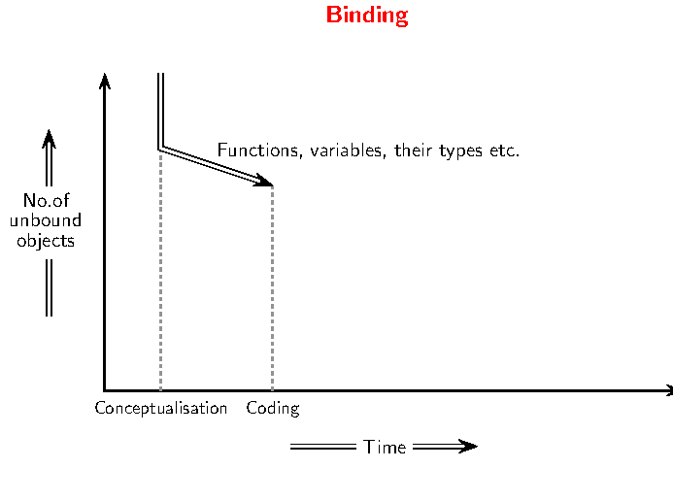

Slide 7
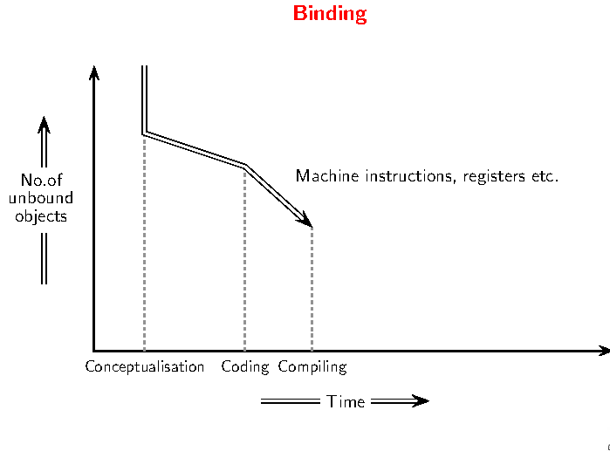

Slide 8
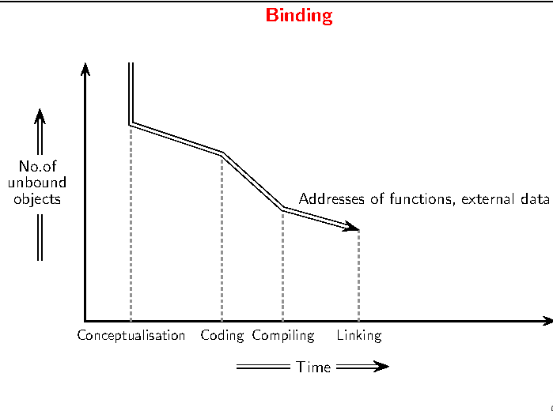

Slide 9
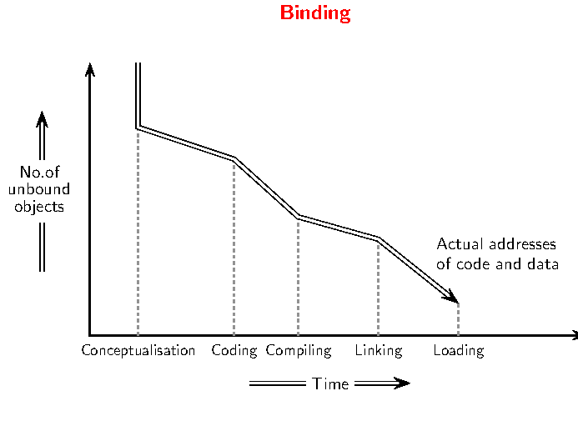

Slide 10
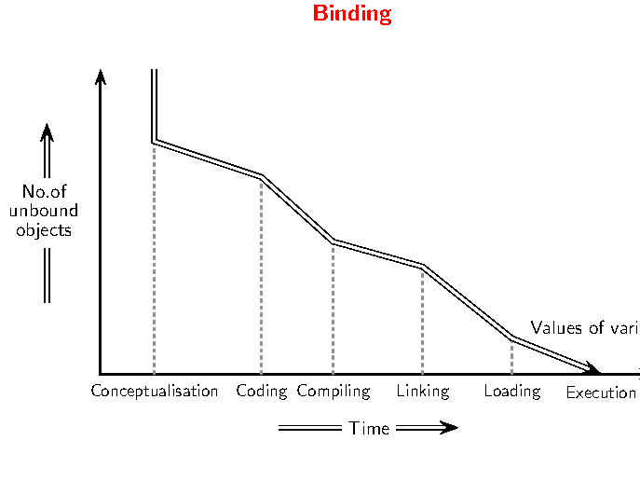

Slide 11
Implementation mechanism for problems

Slide 12
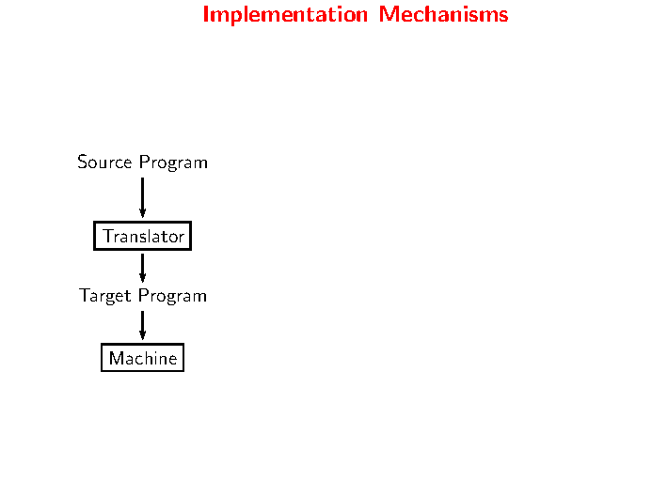

Slide 13
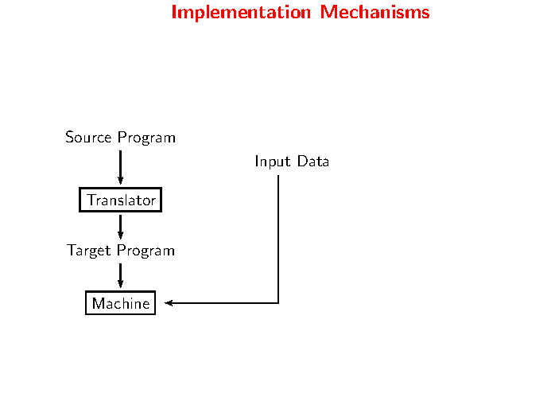

Slide 14
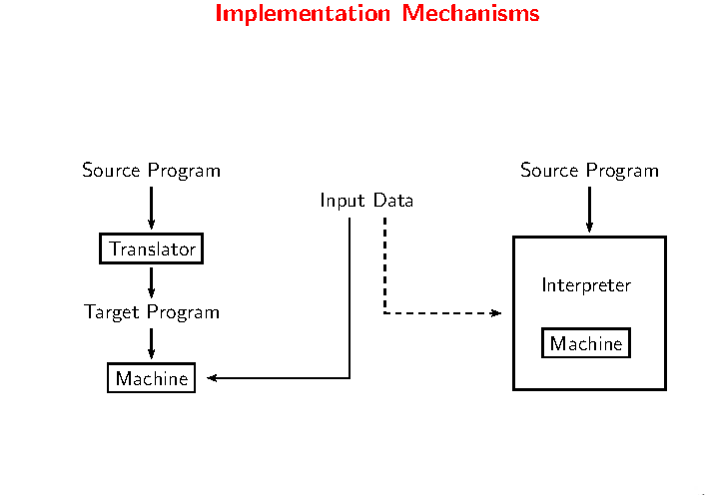

Slide 15
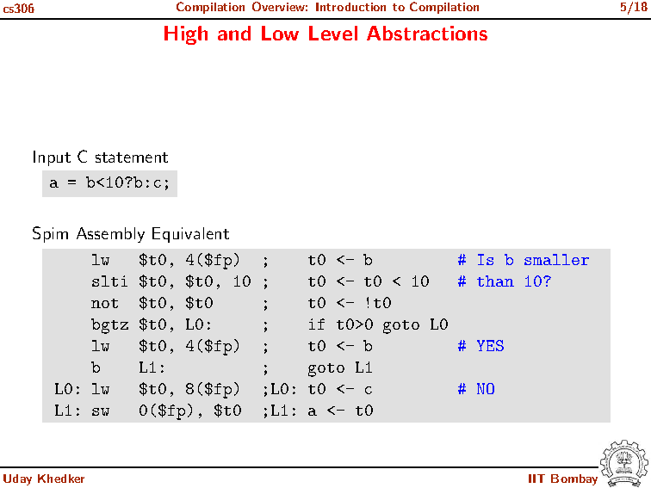
Compiler as solution

Slide 16
Compiler Definition
A compiler is computer software that transforms computer code written in one programming language (the source language) into another programming language (the target language).

Slide 17
Statement of the problem
As per the user point of view, there is need of at least two things in any of these tool:
Firstly, the tools should be easy to understand and implement.
Secondly, it should provide a different interface for lexical phase and syntax as well as sematic analysis phase.
So the problem is to provide to user with such a compiler designing tool which could provide both of these least requirements.

Slide 18
Objective
The main objective of the project is to :
design a source-to-source compiler which can be used to translate the program written in PLY++ framework into PLY framework program which is further interpreted using Python Lex and Yacc to give the required compiler described in PLY++ program.
The main purpose of the project is to provide a compiler designing tool which can be easily understood by its user and along with that it should provide interface for different phases of compiler especially lexical analysis phase and syntax analysis phase.

Slide 19
Primitive Compiler designing Tools

Slide 20
Lex and Yacc Introduction
Typical programming tool for generating compilers
Lex generates C code for a lexical analyser, or scanner. It uses patterns that match strings in the input and convert the strings to tokens.
Yacc generates a C code for a syntax analyser, or parser. Yacc uses grammar rules that allow it to analyse tokens from lex and create a syntax tree.

Slide 21
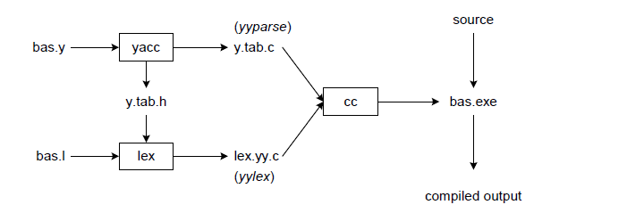
Lex and Yacc workflow

Slide 22
Why need alternative for lex and yacc ?
Difficult to use ?
Slow in working ?
Not Simple ?

Slide 23
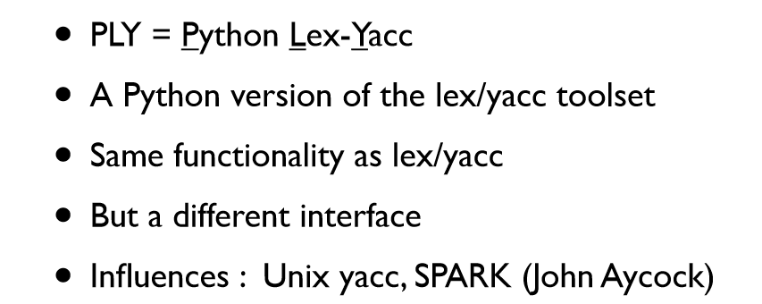
What is PLY

Slide 24
Benefits of PLY
Compiler Writing is hard and the tool should not make it even harder.
PLY is simple : just two modules
Don’t rely on third-party tools
PLY is fast as parsing table is generated and changed only if there is change in grammar rule

Slide 25
But what PLY do not provide ?
A different interface for the token file and the grammar file
We have to write both in the same file and compile it using the python interpreter
So Do we need an alternative for this ?

Slide 26
Dot language
DOT is a graph description language.
DOT graphs are typically files with the file extension gv or dot.
Others, such as lefty, dotty, and grappa, provide an interactive interface.

Slide 27
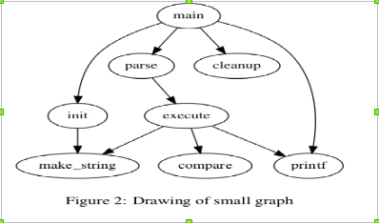
Dot example:
digraph G {
Main -> parse -> execute
Main -> init
Main -> clean_up
Execute -> make_string
Execute -> printf
Init -> make_string
Main -> printf
Execute -> compare
}

Slide 28
PLY++ Tool for Compiler Design

Slide 29
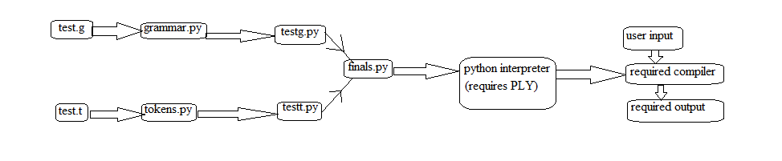
Tool Description (work flow)

Slide 30
Software requirements
Operating system → Unix/Linux based OS
Front End → Java Swing
Scripts → Shell scripts and python scripts
Back End → Python with PLY
Tools → Dot graph tool , image viewer , pdf reader etc.

Slide 31
Tool Functions
Create , edit a lexer file
Create ,edit a grammar file
Compile lexer file
Compiler grammar file
Generating compiler using compiled lexer and grammar file

Slide 32
Implementation of the Project Tool

Slide 33
Basic of Implementation
The implementation of this project is mainly done in two parts : front-end and back-end.
In front end , we will discuss about providing user the GUI mode .
In Back-end mode we will talk about how the inputs given by user is processed.

Slide 34
Front-end
For providing users with GUI mode , we have designed an editor for user using JAVA Swing which provides few basic functionalities to the user such as writing the code, compiling it etc. JAVA Swing is a known platform for creating desktop application so it was much easier to use this for our comfort.
The java program mainly focus on the services that has to provided by the GUI mode of the tool that’s why it has been made with following components:
1. A Menu bar with 5 options
2. A TextArea for input
3. A status bar for showing status

Slide 35
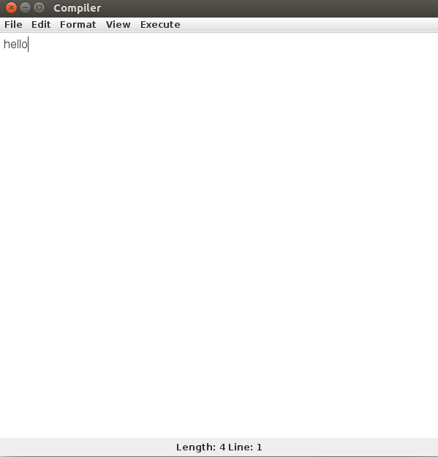
Front - end

Slide 36
Front end
Development of Menu Bar : The menu bar has been completely developed using the JAVAX JMENU component . Using this , we created a new object which has 5 menu options in it . They are files , edit , format , view and execute
Development of TextArea : It has been created as the main component of the entire tool as this is where the user will give its input in to file form. JTEXTAREA has been used for its working.
Development of Status Bar : It has been made using PANEL option in JAVA. The panel has been made with the details and it is later added to the main frame of the progam.

Slide 37
Back end
The input from the user comes usually in two forms , filename.t and filename.g files. The whole work of the back-end part was to process these files and give output as per the requirement of the user . Its working has been explained below.
1. Token processor for filename.t file
2. Grammar processor for filename.g file
3. Final processor for combining the output of 1 and 2 step

Slide 38
Back-end
Making Token Processor: For this we have made a file named tokens.py whih is written in Python using PLY Package . It takes the input filename.t and gives output as filenamet.py which contains the PLY code for the same compiler.
Making Grammar Processor : For this we made a file named as grammar.py which is written in Python using PLY package. It takes the input filename.g and gives output as filenameg.py which contains the PLY code for the same compiler.
Making Final processor: It is a file named finals.py which is just a python program and uses two shell scripts named final and result for its working. Its input is filenamet.py and filenameg.py and its output is filenametfinal.py.

Slide 39
An Execution of the Tool

Slide 40
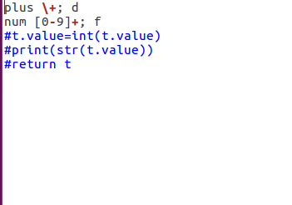
Input files : filename.t

Slide 41
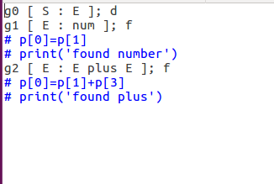
Input files : filename.g

Slide 42
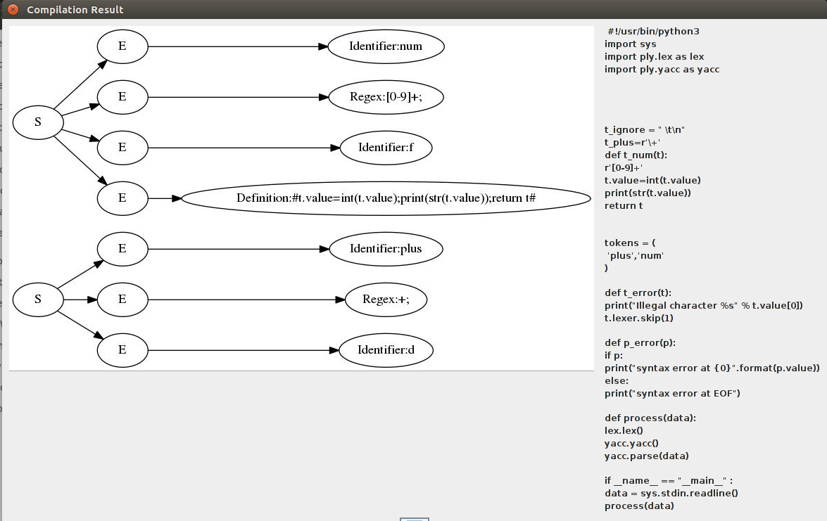
Output for filename.t

Slide 43
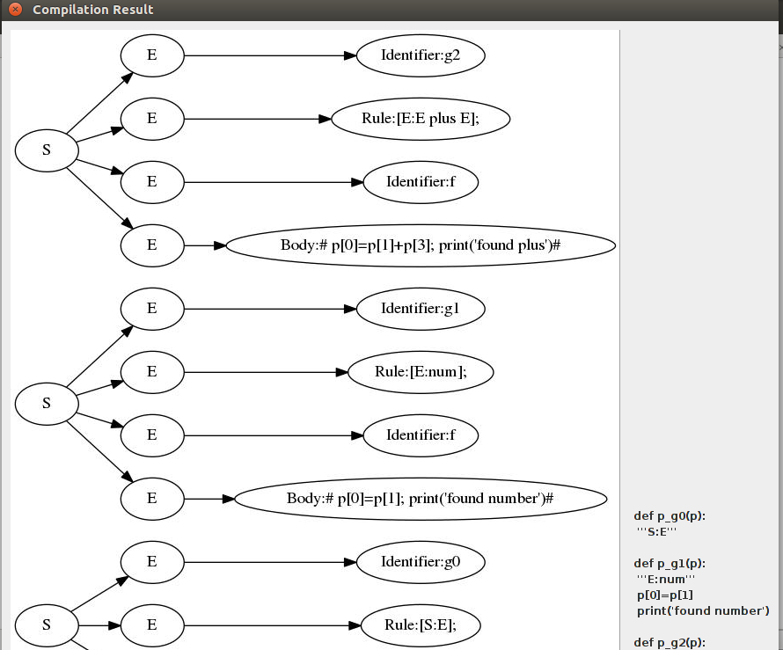
Output for filename.g

Slide 44
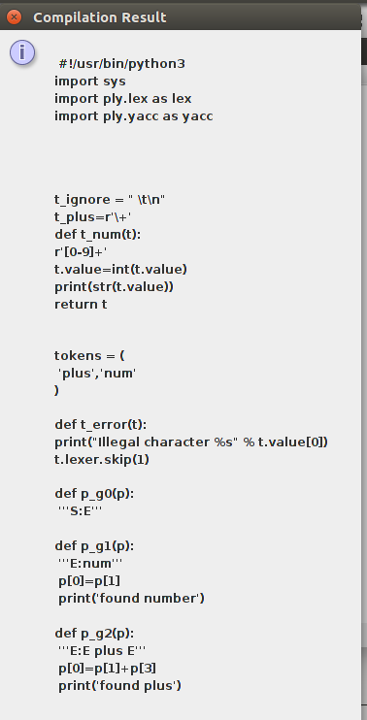
Final required output

Slide 45
Conclusion
In this project work, a tool for compiler designing has been made.
This tool has both front-end and back-end.
Front-end of this tool is designed using java swing i.e. in GUI mode. Till now, no compiler tool has GUI interface in it.
For back-end, Python with PLY package has been used .
The final output is provided to user in GUI mode as well as in a python file too which user can further give to python interpreter to get the required compiler.
This compiler is able to provide two basic requirements to the user i.e. it is easy to understand and easy to implement as well as it provide different interface for lexical analysis and syntax analysis.

Slide 46
Future Work
Future work in GUI Interface: We can provide users with various other options such as project making button, build button, linking button , help guide , etc.
Future work in Compiler: We can further extend our compiler to be completely independent and work on its own if we can somehow create intermediate code from the generated parse tree and then further use that 3AC for generating assembly code followed by its assembling using any known assembler to generate machine code. In this way, we will not need any software for generating the compiler and our language for compiler generation will be completely independent.

